Slide 1
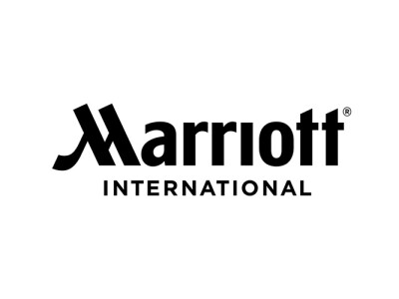
MARRIOTT INTERNATIONAL’S STRATEGIC CYBERSECURITY PLAN
Christopher Phan
Shaquilla Chambers
Zach Zerger
Dr. Branden Williams
Strategic Cybersecurity Practicum CYBS - 8396
Summer 2023
Notes:
Hello, my name is Christopher Phan, and my associates are Shaquilla Chambers and Zach Zerger. We are here to discuss our future plans and implementation of a cybersecurity plan for Marriott International.

Slide 2
AGENDA
Marriott’s Mission, Vision, and Core Values
Our Information Technology Philosophy
Security Organization Structure and Justification
Marriott’s Security Mission, Vision, and Core Values
Security Challenges Presented to Marriott International
Alignment between Business and Security Operations
Notes:
Here is the agenda in what we are planning to discuss throughout this presentation so you may understand the purpose of this new cybersecurity plan and what will be necessary for us to develop an effective and efficient plan that secures our stakeholders’ digital assets and defend Marriott International’s future and reputation.
Firstly we shall delve into Marriott International’s mission statement, vision, and core values so we may remind ourselves of the pillars that Marriott proudly stands on and how this cybersecurity plan will build upon those pillars.
Secondly we shall discuss our new IT philosophy that will highlight the necessity of this cybersecurity plan.
The third topic shall be about the reorganization of Marriott International’s security teams and how they will be oriented to support Marriott.
Our fourth topic will be about detailing Marriott International Security team’s mission, vision, and core values.
Our fifth topic will discuss the security challenges that Marriott International currently faces, giving reasoning why this cybersecurity plan needs to be implemented.
Lastly, we will discuss how both the business side and security side of Marriott intertwine and how they will be both supporting each other for future success.

Slide 3
OUR MISSION & VISION
Marriott International Mission Statement
Creating an environment for customers that is both memorable and pleasant for any occasion.
Marriott International Vision Statement
To be the best and number one travel company in the world.
Notes:
These two statements are pivotal to Marriott International business and how it wants to grow.
Our mission statement is to create an environment for our clients that is the best possible experience for them, something that makes them to continually use our services and become loyal customers for any occasion that requires them to use Marriott.
Our vision statement is to be the greatest travel company in the world, the premiere provider of travel mediums and hospitality leisure services.

Slide 4
OUR CORE VALUES
Prioritizing People
Place emphasis on the experiences of both employees and customers
Innovation in Hospitality
Improving the satisfaction of customers.
Pursuing Excellence
Be the best in all fields that Marriott International.
Uncompromising Standards
Go above and beyond the standards of ethics and legal requirements.
Notes:
These are the main four core values that Marriott International and us hold ourselves to.
We want to emphasize everyone that interacts with Marriott International and bring our best foot forward to both employees and customers.
Innovation is highly important to us so we may stand above our competitors and show that we are willing to enact change to improve our customer experience.
This leads to our pursuit of excellence, everything that we do here in Marriott International we want to be the best in what we do, either it being simple hospitality and guest relations to employee growth and cybersecurity.
Lastly, our core values are highly dependent on integrity, our integrity to upholding ethics, our integrity to upholding the legal standards, but we want to do more to enhance both and more. Integrity is our responsibility to our stakeholders and we need to go above and beyond to show to ur customers that we care.

Slide 5
INFORMATION TECHNOLOGY PHILOSOPHY
This philosophy will reorient Marriott International’s technology usage:
Purpose and direction of this philosophy for Marriott International
Hardware and software requirements
Technology team orientations for Marriott International
Policy assessment for employees
What will be required of our employees to support this new IT philosophy
Notes:
First it is important to establish what a IT philosophy even is and how it will change how Marriott International will operate. What a IT philosophy entails is the direction and the guiding principles of how a company will utilize information technology and assets. Marriott International, we believe, can take advantage of this IT philosophy to help create a culture of transparency for employees and the technology standards we want to uphold from now to the future. The main purpose of this IT philosophy to redirect our employees to safe digital use and reestablish the expectations we have concerning information technology.
This IT philosophy will be more cybersecurity oriented to develop a secure online environment for both our customers and our employees.
To detail the hardware and software requirements that necessitate a safe technology setting. This will include the hardware of workstations of both portable and stationed machines for employees, data centers to hold our digital assets, an installed hard firewall at all locations, servers including application, database, and web servers, network equipment like routers, and of course printing services that can be utilized by clients and employees alike. The software requirements will include soft firewalls that will be installed on all endpoints for employees creating a hybrid firewall environment, multiple operating systems like Linux/Apache and Microsoft Windows Server for our servers, intrusion prevention systems and VPNs, anti-malware applications, and lastly network monitoring tools for logging and analysis. These will be the baseline requirements for a secure network topology.
For team orientation: most of our technology teams will be in-house to secure the transportation of digital assets. Only two teams will be outsourced: our helpdesk team and our external auditors that will work with our in-house auditors to create a redundant compliance structure.
One policy that is important for our employees to know is that we disallow the use of personal devices for work purposes, and that if any employees are required to work off-site or need any machines for their job function will be provided those machines from Marriott International directly. It is important that we bar the use of personal devices to help prevent the exfiltration of our digital assets outside of the company. Marriott International will allow the possibility of remote work, however this will only apply to employees that are capable of remote work for their job function and their productivity metrics will be analyzed to determine if remote work is effective for Marriott.
Finally, we want employees to help contribute to this IT philosophy to the best of their ability, so we want to emphasize employee awareness and training to increase our cyber hygiene and understand the importance of cybersecurity standards. Our company must develop this security culture from the baseline, thus every employee is vital to the success of our IT philosophy.
I will now be directing this discussion to Shaquilla Chambers who will now begin to speak further on our security organization.

Slide 6
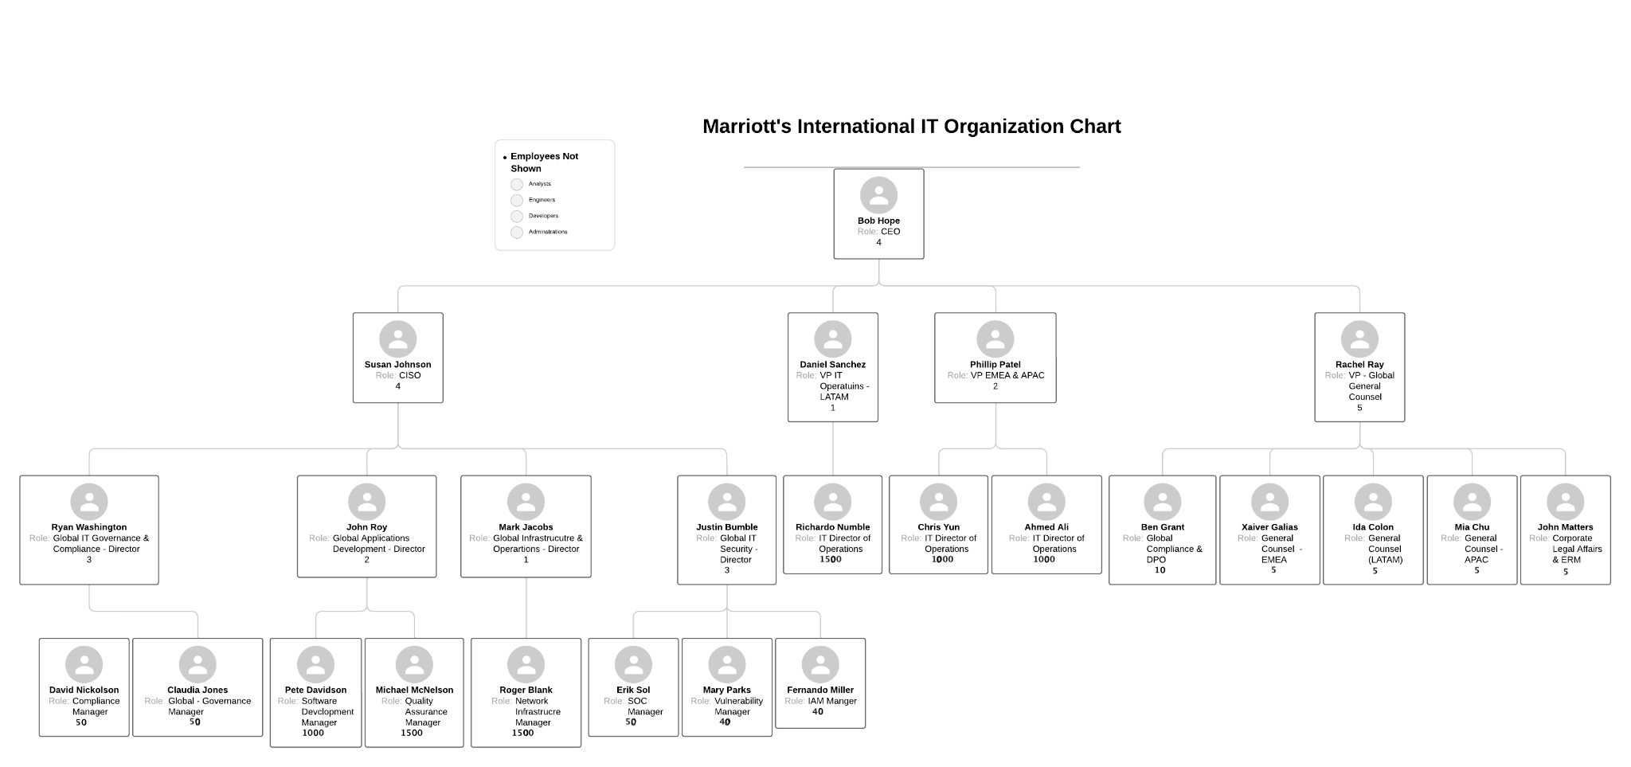
SECURITY ORGANIZATION CHART
Notes:
Marriott’s IT executives consist of the CISO who is responsible for the overall information security strategy and ensuring the protection of sensitive data and information assets. The Global GRC team focuses on ensuring compliance with laws, regulations, and internal policies, and managing risks across the organization.
The Application Development team designs, develops, and maintains software applications and systems within the organization. The Infrastructure & Operations team manages the organization's IT infrastructure, including networks, servers, and data centers, ensuring their availability and reliability.
The IT Security team protects information assets, implements security controls, monitors for threats, and responds to security incidents. DPO (Data Protection Officer) & General Counsel: The DPO ensures compliance with data protection regulations, while the General Counsel provides legal guidance and support to the organization.

Slide 7
SECURITY ORGANIZATION JUSTIFICATION
The demand for cybersecurity experts grows more and more important as the complexity and sophistication of attacks increase.
To develop and improve our strong defense posture and build resilience against potential cyber threats.
To adherence to GDPR and US Data Protection laws to ensure Marriott’s is informed and compliant with current data protection regulations and law.
The team overall objectives is to help us maintain data privacy, safeguard sensitive information, and build trust with our customers.
Notes:
The demand for cybersecurity experts is increasing rapidly due to the emergence of advanced attacks from threat actors. As technology evolves, so do the tactics used by hackers, making it crucial for us to have skilled professionals to defend against these threats. Our organization recognizes the importance of continuously improving our defense capabilities.
Our appointed global data protection officers who play a vital role in keeping us informed about the latest data protection rules and regulations. They ensure our strict adherence to GDPR and US Data Protection laws, safeguarding our customers' personal information and maintaining the trust they place in our organization.

Slide 8
SECURITY MISSION & VISION STATEMENTS
Security Mission
Safeguard Information Assets
Ensure Confidentiality, Integrity, and Availability
Security Vision
Meet Stakeholder Security Expectations
Security Innovation
Security Culture
Notes:
Marriott's security organizational mission is to safeguard information assets from theft, disclosure, unauthorized access, and alteration. The security organization will maintain confidentiality, integrity, and availability of the company's information and systems.
Marriott's security vision is to meet stakeholder security expectations. The company strives to be an innovative, forward-thinking company that can lead the industry in information security practices. The company envisions an information security culture. A security-minded culture will ensure its prosperity as the leading hospitality company in the world.

Slide 9
SECURITY CORE VALUES
Confidentiality
Protect Proprietary Data
Protect Customer Data
Integrity
Accurate and Reliable Data
Prevent Unauthorized Changes
Availability
Redundant Systems
Backup Systems
Security Awareness
Training Program
Best Practices
Notes:
Confidentiality, integrity, availability, and security awareness should make up Marriott's core security values as part of its cybersecurity strategy. Confidentiality is the company's ability to protect its information assets. It is essential to protect the company's proprietary and sensitive customer data. This is important not only for regulatory reasons but also affects the company's reputation and brand.
Data integrity is vital to Marriott. Customers expect their data to be accurate and reliable when interacting with the company. It is also essential that the company prevent unauthorized access changes to proprietary information through security controls.
The availability of Marriott's network is also vital to the success of the company and customer expectations. The company needs to make sure that information systems are available to service the needs of associates and millions of customers.
With the growth of social engineering and phishing attacks, the company must embrace a security culture involving every employee. A security awareness program is one way to promote a security culture and protect the company from the human element.

Slide 10
SECURITY CHALLENGES
Data Security
Customer Data
Employee Data
Proprietary Company Data
Owner/Franchisee/Licensee Data
Third Party Risks
Network of Reservation Vendors
Help Desk Outsourcing
Cloud Security
Notes:
Data security has proven to be the biggest challenge for Marriott. The company has suffered three data breaches since 2018. The company collects a lot of customer, employee, and company data. It processes millions of reservations annually and has millions of reward members that utilize the company's reward application. The company has to focus on various security controls to reduce the risk of another breach.
Marriott is vulnerable to third party risks. The company uses cloud vendors, outsources its help desk, and relies on a network of different booking vendors. The company has to assess these companies' information security stance and make sure they are contractually obligated to protect any of Marriott's sensitive data.

Slide 11
SECURITY CHALLENGES
Insider Threats
Approximately 377,000 Associates
Over 8,000 Locations
Regulatory Challenges
Operates in 138 Countries
Increased Scrutiny
Past Fines
Notes:
Nineteen percent of all cyber attacks involved insider attacks over the past year (Data Breach Investigations Report, 2023). On the surface, nineteen percent may appear as a small challenge, but it poses a more significant challenge for Marriott. Marriott employs over 377,000 associates in over 8,000 locations. The company also has a unique franchisee relationship with most of its hotels. The number of employees and the special relationships make Marriott more vulnerable to insider threats.
Marriott has hotels in 138 countries and captures sensitive customer data. This makes navigating all the compliance and regulatory requirements in each region or country challenging. Recent security breaches have resulted in increased scrutiny from regulators, and the company is still paying legal fees and fines. The company has to ensure it is complying, or it may face steeper penalties in the future.

Slide 12
BUSINESS & SECURITY ALIGNMENT
Conclusion
Communicate Strategic Cybersecurity Plan
Create Security Culture
Measure Results, Reevaluate Plan, Continuously Innovate and Improve
Notes:
In conclusion, this strategic cybersecurity plan should not only be adopted by security staff; it needs to be communicated throughout the enterprise so that employees and stakeholders understand the overall mission, vision, values, and the vital part they play. Security culture must be implemented to ensure the company prospers in a high-security threat environment. Once this plan is implemented, the company needs to measure its effectiveness, reevaluate it, and continuously innovate and change it to meet the needs of an ever-changing cybersecurity field.

Slide 13
REFERENCES
Data Breach Investigations Report (DBIR). (2023). Verizon Enterprise Solutions. https://www.verizon.com/business/resources/T4dc/reports/2023-data-breach-investigations-report-dbir.pdf
General Data Protection Regulation (GDPR) – Official Legal Text. (2022, September 27). General Data Protection Regulation (GDPR). https://gdpr-info.eu/
Marriott International: 2022 Annual Report. (2023). https://marriott.gcs-web.com/static-files/b82978a6-9d28-4e38-9855-fc4ae2cebe11
Notes:
Any questions?

